Slide 1

P O R T O S E G U R O ’ S S A F E D R I V E R P R E D I C T I O N
S A I C H A R I T H G O V A R D H A N A M

Slide 2
T A B L E O F C O N T E N T S
Introduction
Data Overview
Data Preprocessing
Model Building
Model Evaluation
Conclusion

Slide 3
Problem Statement: Porto Seguro wants to improve its ability to predict claims for auto insurance policies by providing a dataset for developing a model that can accurately predict whether a policyholder will file a claim in the next year.

Slide 4
I N T R O D U C T I O N
Auto insurance is a critical industry for ensuring the safety of drivers and protecting their assets in case of accidents. However, accurately assessing the risk of claims is a complex and time- consuming process.
Predictive modeling has become increasingly popular in the insurance industry as a way to improve the accuracy and efficiency of risk assessment.
The Porto Seguro Safe Driver Prediction dataset contains a large amount of information about policyholders, including demographic data, vehicle characteristics, and past claims history, that can be used to train a machine learning model to predict the likelihood of future claims.
The challenge of predicting auto insurance claims is a complex one, as there are many different factors that can contribute to the likelihood of a claim being filed, such as the driver's age, driving history, and the type of vehicle they own.
By developing a predictive model that can accurately assess the risk of claims, Porto Seguro can improve its ability to price policies more accurately, reduce the number of fraudulent claims, and improve overall customer satisfaction.

Slide 5
D A T A O V E R V I E W
The Porto Seguro's Safe Driver Prediction dataset contains data on over 500,000 policyholders, including their demographic information, vehicle information, and history of claims. The dataset consists of 59 features, including 13 binary, 21 categorical, and 25 continuous variables. The target variable is binary, indicating whether or not the policyholder filed an insurance claim in the following year.
Some of the variables in the dataset include:
ID: Unique identifier for each policyholder
Target: Binary variable indicating whether or not the policyholder filed a claim in the following year
Features with prefix 'ps_ind': Binary variables indicating whether or not a policyholder has a certain medical history or property ownership status
Features with prefix 'ps_reg': Continuous variables indicating a policyholder's location in Brazil Features with prefix 'ps_car': Binary and continuous variables indicating a policyholder's vehicle characteristics, such as make and model, age, and damage indicators
Features with prefix 'ps_calc': Continuous variables indicating calculated values based on the other variables in the dataset

Slide 6
D A T A P R E P R O C E S S I N G
Handling uncommon features
In the dataset, there are some features that are uncommon or have very few instances in the dataset. These features can be removed to reduce the complexity of the model and avoid overfitting.
Handling identifiers
The 'id' column in the dataset does not provide any meaningful information for predicting the target variable. Therefore, it can be dropped before modeling.
Handling missing data
The dataset contains missing values denoted by -1, which need to be handled before modeling. This can be done by imputing the missing values with statistical measures such as mean, median or mode.
Encoding categorical features
The dataset contains 21 categorical variables that need to be encoded numerically for modeling. One-hot encoding can be used to create binary columns for each category in the variable.
Splitting the feature and target
Before modelling, it is important to split the dataset into
feature and target matrices. The feature matrix
target
contains all the input variables except the
variable, while the target matrix contains only the target variable. This separation is necessary for model training and evaluation.

Slide 7
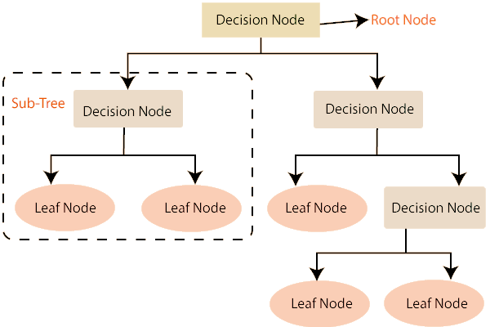
M O D E L B U I L D I N G
Decision Tree
Decision trees are a type of supervised learning algorithm that can be used for both classification and regression tasks.
The algorithm builds a tree-like model of decisions and their possible consequences. Each node in the tree represents a decision or test on a feature, while the branches represent the possible outcomes of the decision.
The algorithm recursively splits the data into subsets based on the values of the features, until the subsets are homogeneous or the maximum depth of the tree is reached.

Slide 8
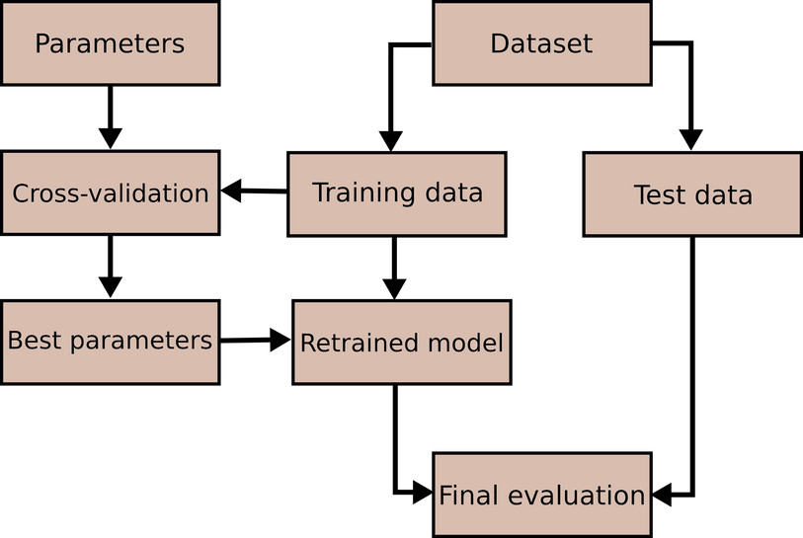
M O D E L B U I L D I N G
Random Forest
Random Forest is an ensemble learning algorithm that combines multiple decision trees to create a more robust and accurate model.
Random Forest works by creating multiple decision trees on different random subsets of the dataset, and then aggregating their predictions to make a final prediction.
Random Forest also includes random feature selection in each decision tree, which helps to reduce overfitting and increase the model's ability to generalize to new data.

Slide 9
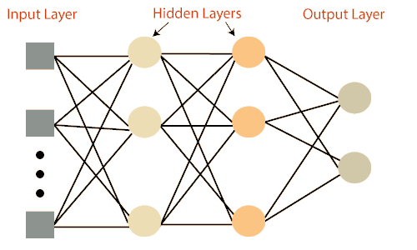
M O D E L B U I L D I N G
MLP Classifier
MLP stands for Multi-Layer Perceptron, which is a type of artificial neural network. MLP Classifier is a supervised learning algorithm used for classification tasks.
MLP Classifier is a feedforward neural network, meaning that the input data is passed through the network in one direction, with no loops or feedback connections.
MLP Classifier can learn non-linear relationships between input features and output classes, making it a powerful tool for complex classification tasks.

Slide 10
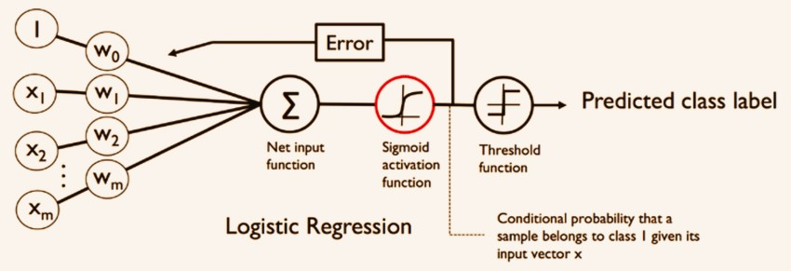
M O D E L B U I L D I N G
Logistic Regression
Logistic regression is a statistical method for analyzing a dataset in which there are one or more independent variables that determine an outcome. The outcome is measured with a dichotomous variable.
The algorithm for logistic regression involves estimating the coefficients of a linear equation, which relates the independent variables to the probability of the outcome. The coefficients are estimated using a maximum likelihood estimation method, which seeks to maximize the likelihood of the observed data given the estimated coefficients.
Once the coefficients are estimated, they can be used to make predictions on new data by applying the logistic function to the
linear equation. The logistic function transforms the linear
1, which
equation into a probability value between 0 and
represents the probability of the outcome for a given set of input variables.

Slide 11



M O D E L E V A L U A T I O N - A C C U R A C Y
92.6%
96.3%
96.3%
62.1%
Logistic Regression
Decision Tree
Random Forest
MLP Classifier

Slide 12


C O N C L U S I O N
The Porto Seguro Safe Driver Prediction dataset was analysed using machine learning algorithms to predict whether a driver will file an insurance claim based on a set of features provided by Porto Seguro.
The Random Forest and MLP Classifier models were found to have the best performance in terms of accuracy, precision, and recall, and were used to generate predictions on new data.
Data preprocessing techniques such as handling missing data, encoding categorical features, and splitting the feature and target variables were applied to improve the quality of the dataset and increase the performance of the machine learning models.
The results of this analysis can be used by Porto Seguro to identify high-risk drivers and develop targeted insurance policies that mitigate risk and reduce the number of insurance claims filed by their customers.
The successful application of machine learning algorithms to the Porto Seguro Safe Driver Prediction dataset demonstrates the potential for data-driven approaches to improve the insurance industry's risk assessment and underwriting processes, leading to more efficient and cost-effective insurance policies for both customers and insurance providers.

Slide 13


